Slide 1

Wine Quality
By Jacob Gilbreath

Slide 2
The Data
Wine Quality Data Set (https://archive.ics.uci.edu/ml/datasets/wine+quality)
Red Wines from the North of Portugal (1,599 Wines)
Predictor Variables
PH
Fixed Acidity
Volatile Acidity
Citric Acids
Residual Sugar
Chlorides
Free Sulfur Dioxide
Total Sulfur Dioxide
Density
Sulphates
Alcohol
Output Variable
Quality
Given a score between 0 and 10
Average of 3 different scores from sensory data

Slide 3
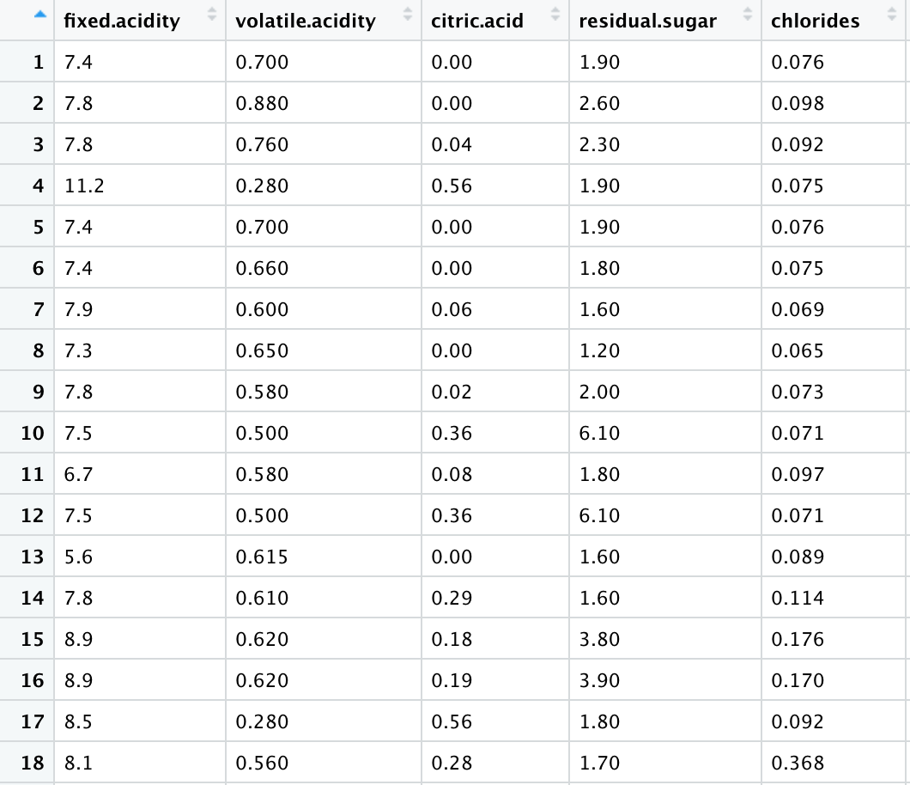
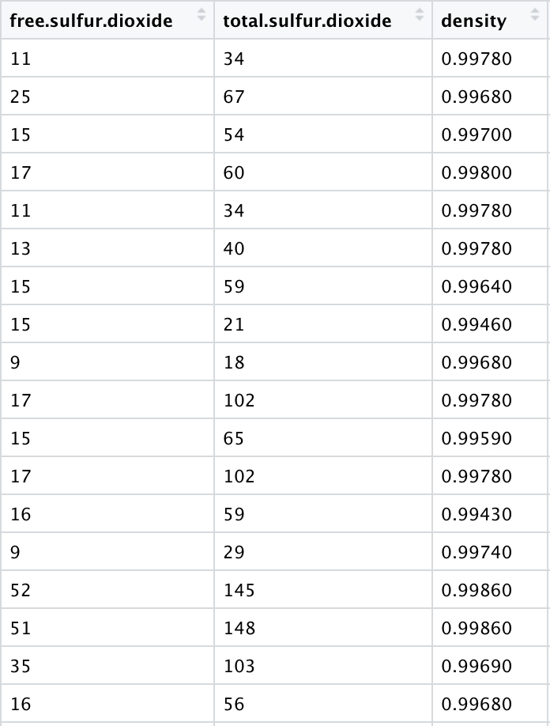
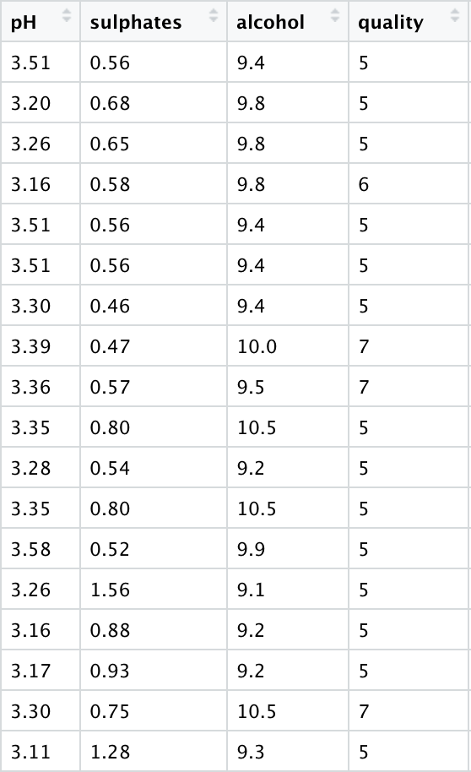
Sample Data

Slide 4
Research question #1
Which physiochemical features has the greatest individual affect on the overall quality of the wine?
Data | Fixed Acidity | Volatile Acidity | Citric Acids | Residual Sugar | Chlorides | Free SO2 | Total SO2 | Density | Sulphates | Alcohol
Intercept | 5.15 | 6.56 | 5.38 | 5.61 | 5.83 | 5.69 | 5.85 | 80.24 | 4.85 | 1.87
Slope | 0.05 | -1.7 | 0.93 | 0.007 | -2.21 | -0.003 | -0.002 | -74.85 | 1.19 | 0.36
R^2 | 0.014 | 0.15 | 0.05 | -0.0004 | 0.016 | 0.0019 | 0.03 | 0.029 | 0.06 | 0.226

Slide 5
Graphs, Alcohol

Slide 6
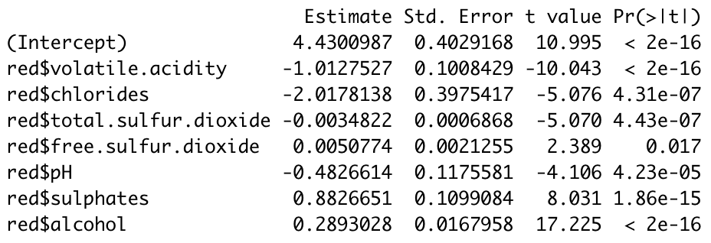
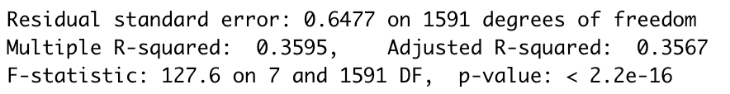
“Best” Linear Model
The linear model with the largest R^2 (0.3567) used:
Volatile Acidity
Chlorides
Free Sulfur Dioxide
Total Sulfur Dioxide
PH
Sulphates
Alcohol

Slide 7
Research Question #2
What are the biggest contributors to what makes a wine great or poor?
Determined outliers in the quality variable ,using base R boxplot
A quality of 8 for a wine, would place it in the “great” category (18 wines)
A quality of 3, would place it in the “poor” category (10 wines)

Slide 8
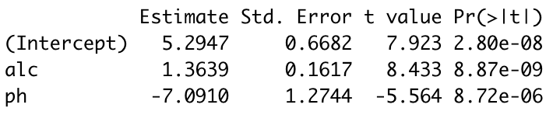
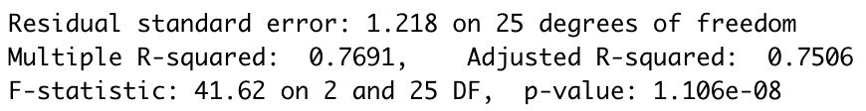
Same model, different data
Ran the same linear model as before, except I only used the “great” and “poor” wines as defined earlier
As before, alcohol was a large contributor to the accuracy of the model
Volatile acidity, however, had less of an impact and was replaced by PH

Slide 9
Classification

Slide 10
Classification, “The Quality Line”
The purple dashed line is an average of the 2 individual regression lines

Slide 11
Conclusion
Research Question 1
Alcohol level and volatile acidity are the largest individual contributors to wine quality when examining the entire set of wines
The linear regression is not strong enough to prove correlation between any individual variable or combination of variables to the quality of the wine
Research Question 2
By removing all wines with quality between 4 and 7, the alcohol and PH levels of the wines seemed to have the best correlation with quality
When plotting the wines with respect to their alcohol and PH, the “great” wines are seen to have a larger alcohol level and a lower PH
When plotting the wines with respect to their alcohol and PH, the “poor” wines are seen to have a lower alcohol level and a higher PH

